Slide 1
Computer Networks

Slide 2
Computer networking refers to interconnected computing devices that can exchange data and share resources with each other. These networked devices use a system of rules, called communications protocols, to transmit information over physical or wireless technologies.

Slide 3
For ex:
You can connect your smartphone in your smart TV,gaming console and a printer simultaneously either using cables or through wifi.It is termed as Computer Network.

Slide 4
Advantages of Network
Share resources:
Such as printers and scanners.This is cheaper than buying equipment for each computer.
Share storage:
Being able to access files from any machines on the network can share data.
Can Share Software:
Software can be installed centrally rather than on each machine.Metering software can then be used to limit the number of copies being run at any one time.This is much cheaper than buying licenses for every machine.

Slide 5
Disadvantages of Networks
The systems are more sophisticated and complex to run.This can add to costs and you may need specialist staff to run the network.
If networks are badly managed.Services can become unusable and productivity falls.
If software and files are held centrally,it may be impossible to carry out any work if the central server fails.People reliant on the communications,If these fail,It can cause havoc

Slide 6
File security is more important especially if connected to WANs eg:protection from viruses.
A computer becomes a workstation of a network as soon as it is attached to a network.

Slide 7
Components of Computer Network
Joining two components with a cable won’t form a network.There are many components that together make a network.The major components of a computer network.
1.Host/Nodes
2.Servers
3.Client
4.Network Hardware(such as NIC,Router,Switch,Hub)

Slide 8
5.Communication Channel(such as cables,radio-links etc)
6.Software(such as protocols,network operating system etc)
7.Network Services(such as BNS,File-Sharing etc)

Slide 9
Host or nodes:
The term host or node refers to the computers that are attached to a network and are seeking to share the resources of the network
Pc,laptop,smartphones when connect to a network become hosts.

Slide 10
Server:
A server is very important computer in a network.A server is responsible for making the networking tasks happen.
A server facilitaties networking tasks like sharing of data,resource sharing,communication among hosts etc.
Small networks:
Sharable stuff like (files,data,software) is stored on the server.A network can more than one server also.Each server has a unique name on the network and all users of network identify the server by its unique name.
Big Networks:
There can be servers dedicated to specialized tasks
For eg:file server only handles files related requests.
A Printer server only handles printing requests.

Slide 11
Client:
Client is a related term.A client computer is a host computer that request for some services from a server.

Slide 12
Network Hardware:
Other than host and wiring,a network requires specialized hardware to carry out various roles,such as establishing corrections,controlling network traffic.
NIC (Network Interface card)-It is a network card attached to a host so as to establish network connections.Every NIC card has a unique physical address called the MAC (Media Access Control)address which is a 6byte(48 byte) address assigned by the NIC manufacturer.An NIC is also called Network Interface Unit(NIU) or Terminal Access Point(TAP)
Hub,Switch,router – Connectivity devices

Slide 13
Communication Channel:
Hosts in a network interact with other host and server(s) through a communication channel or communication medium.The communication channel can either be wired or wireless.
Wired Communication Channels:
A communication channel is the medium used to transport information from one network device to another. Wired channels transport data through wires and cables. For eg:Twisted-pair cables,coaxial cables,fibre-optic cables.

Slide 14
Wireless Communication channels:
When host and server(s) are connected with one another through unguided media like radio waves,satellite etc.
EX:Radiowaves,Microwaves,Satellite,infrared waves,laser etc..

Slide 15
Software:
A protocol refers to a pre-decided set of rules using which all parties of a network connect and interact with one another.
A network operating system is a specialized operating system that can handle networking tasks.
Network Services:
The application that provide different functionalities over a network such as DNS(Domain Name System),File Sharing,VOIP(Voice over IP)

Slide 16
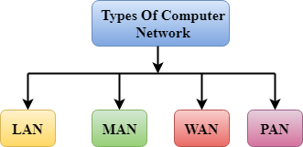
A computer network is a group of computers linked to each other that enables the computer to communicate with another computer and share their resources, data, and applications.

Slide 17
Local Area Network:
Local Area Network is a group of computers connected to each other in a small area such as building, office.
LAN is used for connecting two or more personal computers through a communication medium such as twisted pair, coaxial cable, etc.
It is less costly as it is built with inexpensive hardware such as hubs, network adapters, and ethernet cables.
The data is transferred at an extremely faster rate in Local Area Network.
Local Area Network provides higher security.

Slide 18
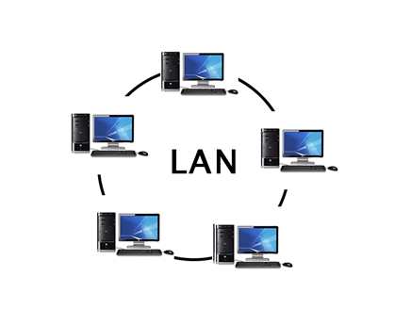

Slide 19
Personal Area Network is a network arranged within an individual person, typically within a range of 10 meters.
Personal Area Network is used for connecting the computer devices of personal use is known as Personal Area Network.
Personal Area Network covers an area of 30 feet.
Personal computer devices that are used to develop the personal area network are the laptop, mobile phones, media player and play stations.

Slide 20
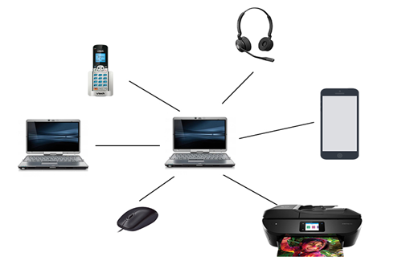

Slide 21
A metropolitan area network is a network that covers a larger geographic area by interconnecting a different LAN to form a larger network.
Government agencies use MAN to connect to the citizens and private industries.
In MAN, various LANs are connected to each other through a telephone exchange line.

Slide 22
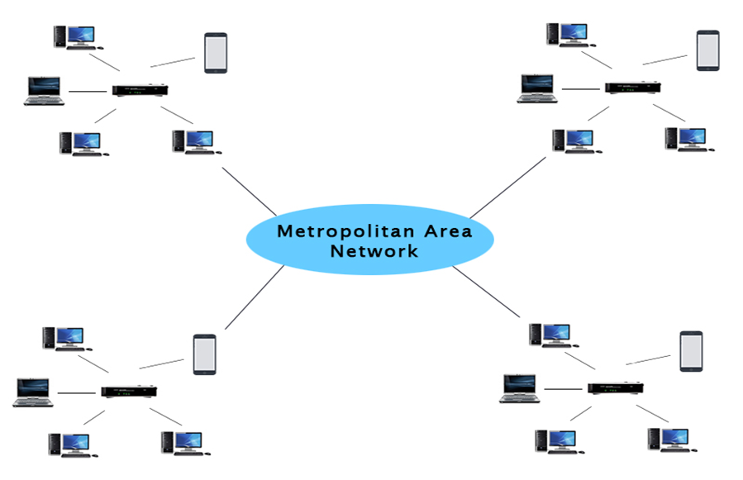

Slide 23
Uses Of Metropolitan Area Network:
MAN is used in communication between the banks in a city.
It can be used in an Airline Reservation.
It can be used in a college within a city.
It can also be used for communication in the military.

Slide 24
WAN(Wide Area Network)
A Wide Area Network is a network that extends over a large geographical area such as states or countries.
A Wide Area Network is quite bigger network than the LAN.
A Wide Area Network is not limited to a single location, but it spans over a large geographical area through a telephone line, fibre optic cable or satellite links.
The internet is one of the biggest WAN in the world.
A Wide Area Network is widely used in the field of Business, government, and education.

Slide 25
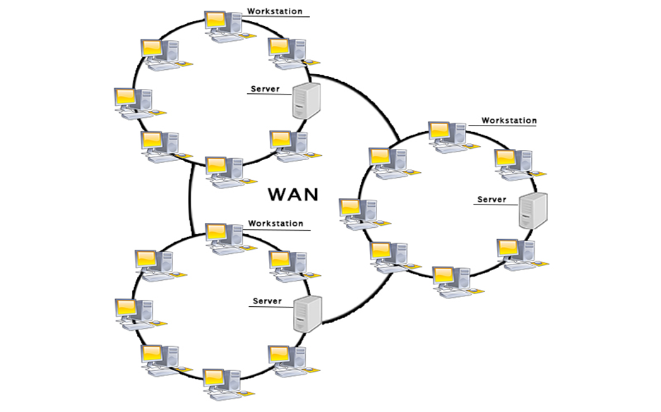

Slide 26
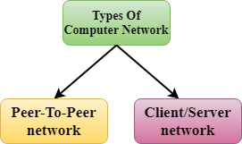

Slide 27
Peer to Peer (P2P) Networks:
In peer-to-peer (P2P) networking, a group of computers are linked together with equal permissions and responsibilities for processing data.

Slide 28
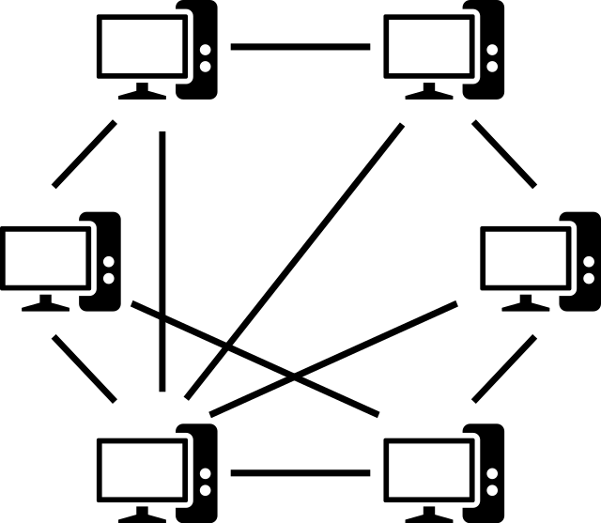

Slide 29
A client-server network is the medium through which clients access resources and services from a central computer, via either a local area network (LAN) or a wide-area network (WAN), such as the Internet.

Slide 30
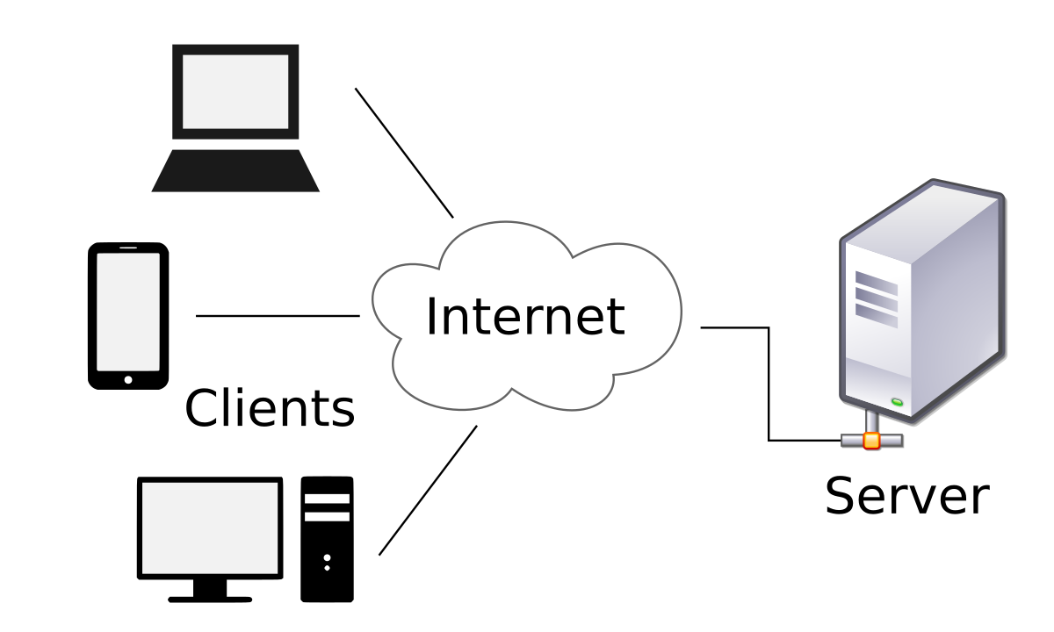

Slide 31
ARPANET
In 1969 ARPANET was started to connect computers at U.S.defense & different universities.
In 1980 NSF net was started to make a high-capacity network to be used strictly for academic and engineering research.
In 1990s Internetworking of ARPANET,NSFnet and other private networks resulted into internet.

Slide 32
The Internet
Internet:
The internet is a world-wide network of computer networks.
Gateway:
A Gateway is a device that connects dissimilar networks.
BackBone:
A Backbone is central inter connecting structure that connects one or more networks just like the trunk of a tree or the spine of a human being.

Slide 33
Internet Functioning
TCP-(Transmission control protocol) part is responsible for dividing the file/message into packets on the source computer.It (TCP) is also responsible for reassembling the received packets at the destination or recipient computer.
IP-Internet Protocol part is responsible for handling the address of destination computer so that each packet is routed(sent) to its proper destination.

Slide 34
The Interspace
Interspace is a client/server software program that allows multiple users to communicate online with real-time audio,video and text chat in dynamic 3D environments.

